Slide 1
Data Cleaning and Preparation: Handling Missing Data, Data Transformation, String Manipulation.

Slide 2
During the course of doing data analysis and modeling, a significant amount of time is spent on data preparation: loading, cleaning, transforming, and rearranging.
Such tasks are often reported to take up 80% or more of an analyst’s time. Sometimes the way that data is stored in files or databases is not in the right format for a particular task.
We discuss tools for missing data, duplicate data, string manipulation, and some other analytical data transformations.

Slide 3
Handling Missing Data
Missing data occurs commonly in many data analysis applications. One of the goals of pandas is to make working with missing data as painless as possible.
The way that missing data is represented in pandas objects is somewhat imperfect, but it is functional for a lot of users. For numeric data, pandas uses the floating-point value NaN (Not a Number) to represent missing data.

Slide 4
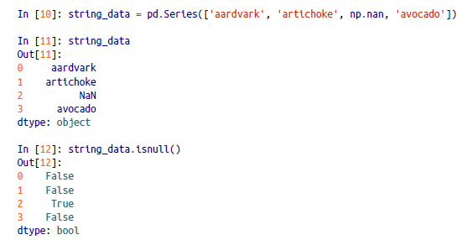

Slide 5
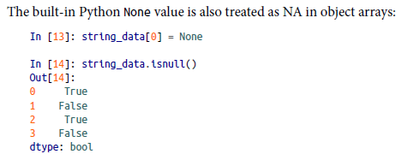
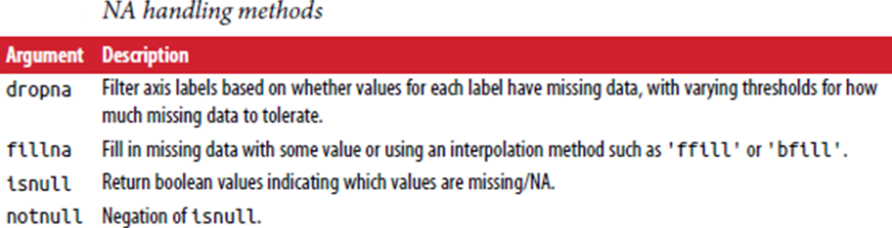

Slide 6
Filtering Out Missing Data
There are a few ways to filter out missing data.
We always have the option to do it by hand using pandas.isnull and boolean indexing, the dropna can be helpful.
In [15]: from numpy import nan as NA
In [16]: data = pd.Series([1, NA, 3.5, NA, 7])
In [17]: data.dropna()
Out[17]:
0 1.0
2 3.5
7.0
This is equivalent to:
In [18]: data[data.notnull()]
Out[18]:
0 1.0
2 3.5
4 7.0

Slide 7
With DataFrame objects, things are a bit more complex. We may want to drop rows or columns that are all NA or only those containing any NAs.
dropna by default drops any row containing a missing value.
In [19]: data = pd.DataFrame([[1., 6.5, 3.], [1., NA, NA],[NA, NA, NA], [NA, 6.5, 3.]])
In [20]: cleaned = data.dropna()
In [21]: data
Out[21]:
0 1 2
0 1.0 6.5 3.0
1 1.0 NaN NaN
2 NaN NaN NaN
3 NaN 6.5 3.0
In [22]: cleaned
Out[22]:
0 1 2
0 1.0 6.5 3.0

Slide 8
Passing how='all' will only drop rows that are all NA:
In [23]: data.dropna(how='all')
Out[23]:
0 1 2
0 1.0 6.5 3.0
1 1.0 NaN NaN
NaN 6.5 3.0
To drop columns in the same way, pass axis=1:
In [25]: data
Out[25]:
0 1 2 3
0 1.0 6.5 3.0 NaN
1 1.0 NaN NaN NaN
2 NaN NaN NaN NaN
3 NaN 6.5 3.0 NaN
In [26]: data.dropna(axis=1, how='all')
Out[26]:
0 1 2
0 1.0 6.5 3.0
1 1.0 NaN NaN
2 NaN NaN NaN
3 NaN 6.5 3.0

Slide 9
Suppose we want to keep only rows containing a certain number of observations. We can indicate this with the thresh argument:
In [27]: df = pd.DataFrame(np.random.randn(7, 3))
In [28]: df.iloc[:4, 1] = NA
In [29]: df.iloc[:2, 2] = NA
In [30]: df
Out[30]:
0 1 2
0 -0.204708 NaN NaN
1 -0.555730 NaN NaN
2 0.092908 NaN 0.769023
3 1.246435 NaN -1.296221
4 0.274992 0.228913 1.352917
5 0.886429 -2.001637 -0.371843
6 1.669025 -0.438570 -0.539741

Slide 10
In [31]: df.dropna()
Out[31]:
0 1 2
4 0.274992 0.228913 1.352917
5 0.886429 -2.001637 -0.371843
6 1.669025 -0.438570 -0.539741
In [32]: df.dropna(thresh=2)
Out[32]:
0 1 2
2 0.092908 NaN 0.769023
3 1.246435 NaN -1.296221
4 0.274992 0.228913 1.352917
5 0.886429 -2.001637 -0.371843
6 1.669025 -0.438570 -0.539741

Slide 11
Filling In Missing Data
Rather than filtering out missing data (and potentially discarding other data along with it), we may want to fill in the “holes” in any number of ways.
For most purposes, the fillna method is the workhorse function to use.
In [33]: df.fillna(0)
Out[33]:
0 1 2
0 -0.204708 0.000000 0.000000
1 -0.555730 0.000000 0.000000
2 0.092908 0.000000 0.769023
3 1.246435 0.000000 -1.296221
4 0.274992 0.228913 1.352917
5 0.886429 -2.001637 -0.371843
6 1.669025 -0.438570 -0.539741

Slide 12
Calling fillna with a dict,we can use a different fill value for each column:
In [34]: df.fillna({1: 0.5, 2: 0})
Out[34]:
0 1 2
0 -0.204708 0.500000 0.000000
1 -0.555730 0.500000 0.000000
2 0.092908 0.500000 0.769023
3 1.246435 0.500000 -1.296221
4 0.274992 0.228913 1.352917
5 0.886429 -2.001637 -0.371843
6 1.669025 -0.438570 -0.539741

Slide 13
fillna returns a new object, but we can modify the existing object in-place:
In [35]: _ = df.fillna(0, inplace=True)
In [36]: df
Out[36]:
0 1 2
0 -0.204708 0.000000 0.000000
1 -0.555730 0.000000 0.000000
2 0.092908 0.000000 0.769023
3 1.246435 0.000000 -1.296221
4 0.274992 0.228913 1.352917
5 0.886429 -2.001637 -0.371843
6 1.669025 -0.438570 -0.539741

Slide 14
The same interpolation methods available for reindexing can be used with fillna:
In [37]: df = pd.DataFrame(np.random.randn(6, 3))
In [38]: df.iloc[2:, 1] = NA
In [39]: df.iloc[4:, 2] = NA
In [40]: df
Out[40]:
0 1 2
0 0.476985 3.248944 -1.021228
1 -0.577087 0.124121 0.302614
2 0.523772 NaN 1.343810
3 -0.713544 NaN -2.370232
4 -1.860761 NaN NaN
5 -1.265934 NaN NaN

Slide 15
In [41]: df.fillna(method='ffill')
Out[41]:
0 1 2
0 0.476985 3.248944 -1.021228
1 -0.577087 0.124121 0.302614
2 0.523772 0.124121 1.343810
3 -0.713544 0.124121 -2.370232
4 -1.860761 0.124121 -2.370232
5 -1.265934 0.124121 -2.370232
In [42]: df.fillna(method='ffill', limit=2)
Out[42]:
0 1 2
0 0.476985 3.248944 -1.021228
1 -0.577087 0.124121 0.302614
2 0.523772 0.124121 1.343810
3 -0.713544 0.124121 -2.370232
4 -1.860761 NaN -2.370232
5 -1.265934 NaN -2.370232

Slide 16
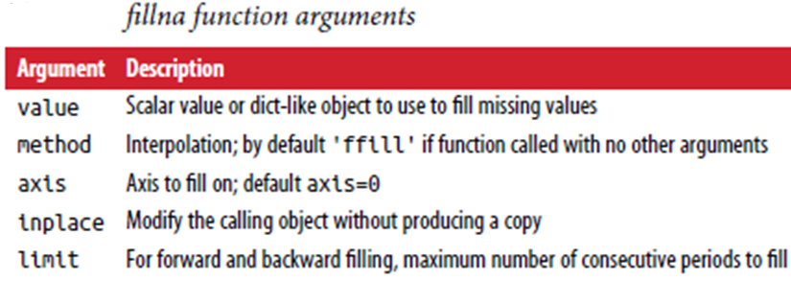
With fillna we can do lots of other things with a little creativity.
For example, we might pass the mean or median value of a Series:
In [43]: data = pd.Series([1., NA, 3.5, NA, 7])
In [44]: data.fillna(data.mean())
Out[44]:
0 1.000000
1 3.833333
2 3.500000
3 3.833333
4 7.000000

Slide 17
Data Transformation
Removing Duplicates
Duplicate rows may be found in a DataFrame for any number of reasons. Here is an
example:
In [45]: data = pd.DataFrame({'k1': ['one', 'two'] * 3 + ['two'],'k2': [1, 1, 2, 3, 3, 4, 4]})
In [46]: data
Out[46]:
k1 k2
0 one 1
1 two 1
2 one 2
3 two 3
4 one 3
5 two 4
6 two 4

Slide 18
The DataFrame method duplicated returns a boolean Series indicating whether each row is a duplicate or not:
In [47]: data.duplicated()
Out[47]:
0 False
1 False
2 False
3 False
4 False
5 False
6 True

Slide 19
drop_duplicates returns a DataFrame where the duplicated array is False:
In [48]: data.drop_duplicates()
Out[48]:
k1 k2
0 one 1
1 two 1
2 one 2
3 two 3
4 one 3
5 two 4

Slide 20
Both of these methods by default consider all of the columns; alternatively, we can specify any subset of them to detect duplicates.
In [49]: data['v1'] = range(7)
In [50]: data.drop_duplicates(['k1'])
Out[50]:
k1 k2 v1
0 one 1 0
1 two 1 1
duplicated and drop_duplicates by default keep the first observed value combination. Passing keep='last' will return the last one:
In [51]: data.drop_duplicates(['k1', 'k2'], keep='last')
Out[51]:
k1 k2 v1
0 one 1 0
1 two 1 1
2 one 2 2
3 two 3 3
4 one 3 4
6 two 4 6

Slide 21
Transforming Data Using a Function or Mapping
For many datasets, we may wish to perform some transformation based on the values in an array, Series, or column in a DataFrame.
Consider an example of data collected about various kinds of meat:
In [52]: data = pd.DataFrame({'food': ['bacon', 'pulled pork', 'bacon', 'Pastrami', 'corned beef', 'Bacon', 'pastrami', 'honey ham', 'nova lox'], 'ounces': [4, 3, 12, 6, 7.5, 8, 3, 5, 6]})
In [53]: data
Out[53]:
food ounces
0 bacon 4.0
1 pulled pork 3.0
2 bacon 12.0
3 Pastrami 6.0
4 corned beef 7.5
5 Bacon 8.0
6 pastrami 3.0
7 honey ham 5.0
8 nova lox 6.0

Slide 22
Suppose we wanted to add a column indicating the type of animal that each food came from.
Let’s write down a mapping of each distinct meat type to the kind of animal:
meat_to_animal = {'bacon': 'pig',
'pulled pork': 'pig',
'pastrami': 'cow',
'corned beef': 'cow',
'honey ham': 'pig',
'nova lox': 'salmon'}

Slide 23
In [55]: lowercased = data['food'].str.lower()
In [56]: lowercased
Out[56]:
0 bacon
1 pulled pork
2 bacon
3 pastrami
4 corned beef
5 bacon
6 pastrami
7 honey ham
8 nova lox

Slide 24
In [57]: data['animal'] = lowercased.map(meat_to_animal)
In [58]: data
Out[58]:
food ounces animal
0 bacon 4.0 pig
1 pulled pork 3.0 pig
2 bacon 12.0 pig
3 Pastrami 6.0 cow
4 corned beef 7.5 cow
5 Bacon 8.0 pig
6 pastrami 3.0 cow
7 honey ham 5.0 pig
8 nova lox 6.0 salmon

Slide 25
We could also have passed a function that does all the work:
In [59]: data['food'].map(lambda x: meat_to_animal[x.lower()])
Out[59]:
0 pig
1 pig
2 pig
3 cow
4 cow
5 pig
6 cow
7 pig
8 salmon
Using map is a convenient way to perform element-wise transformations and other data cleaning–related operations.

Slide 26
Replacing Values
Filling in missing data with the fillna method is a special case of more general value replacement.
In [60]: data = pd.Series([1., -999., 2., -999., -1000., 3.])
In [61]: data
Out[61]:
0 1.0
1 -999.0
2 2.0
3 -999.0
4 -1000.0
5 3.0
replace, produces a new Series (unless we pass inplace=True)
In [62]: data.replace(-999, np.nan)
Out[62]:
0 1.0
1 NaN
2 2.0
3 NaN
-1000.0
5 3.0

Slide 27
If we want to replace multiple values at once, we instead pass a list and then the substitute value:
In [63]: data.replace([-999, -1000], np.nan)
Out[63]:
0 1.0
1 NaN
2 2.0
3 NaN
4 NaN
3.0
To use a different replacement for each value, pass a list of substitutes:
In [64]: data.replace([-999, -1000], [np.nan, 0])
Out[64]:
0 1.0
1 NaN
2 2.0
3 NaN
4 0.0
5 3.0

Slide 28
The argument passed can also be a dict:
In [65]: data.replace({-999: np.nan, -1000: 0})
Out[65]:
0 1.0
1 NaN
2 2.0
3 NaN
4 0.0
5 3.0

Slide 29
Renaming Axis Indexes
Like values in a Series, axis labels can be similarly transformed by a function or mapping of some form to produce new, differently labeled objects.
We can also modify the axes in-place without creating a new data structure.
In [66]: data = pd.DataFrame(np.arange(12).reshape((3, 4)),index=['Ohio', 'Colorado', 'New York'], columns=['one', 'two', 'three', 'four'])
Like a Series, the axis indexes have a map method:
In [67]: transform = lambda x: x[:4].upper()
In [68]: data.index.map(transform)
Out[68]: Index(['OHIO', 'COLO', 'NEW '], dtype='object')

Slide 30
We can assign to index, modifying the DataFrame in-place:
In [69]: data.index = data.index.map(transform)
In [70]: data
Out[70]:
one two three four
OHIO 0 1 2 3
COLO 4 5 6 7
NEW 8 9 10 11
If we want to create a transformed version of a dataset without modifying the original, a useful method is rename:
In [71]: data.rename(index=str.title, columns=str.upper)
Out[71]:
ONE TWO THREE FOUR
Ohio 0 1 2 3
Colo 4 5 6 7
New 8 9 10 11

Slide 31
rename can be used in conjunction with a dict-like object providing new values for a subset of the axis labels:
In [72]: data.rename(index={'OHIO': 'INDIANA'}, columns={'three': 'peekaboo'})
Out[72]:
one two peekaboo four
INDIANA 0 1 2 3
COLO 4 5 6 7
NEW 8 9 10 11
Discretization and Binning
Continuous data is often discretized or otherwise separated into “bins” for analysis.

Slide 32
In [75]: ages = [20, 22, 25, 27, 21, 23, 37, 31, 61, 45, 41, 32]
Let’s divide these into bins of 18 to 25, 26 to 35, 36 to 60, and finally 61 and older. To do so, we have to use cut, a function in pandas:
In [76]: bins = [18, 25, 35, 60, 100]
In [77]: cats = pd.cut(ages, bins)
In [78]: cats
Out[78]:
[(18, 25], (18, 25], (18, 25], (25, 35], (18, 25], ..., (25, 35], (60, 100], (35,60], (35, 60], (25, 35]]
Length: 12
Categories (4, interval[int64]): [(18, 25] < (25, 35] < (35, 60] < (60, 100]]

Slide 33
In [79]: cats.codes
Out[79]: array([0, 0, 0, 1, 0, 0, 2, 1, 3, 2, 2, 1], dtype=int8)
In [80]: cats.categories
Out[80]:
IntervalIndex([(18, 25], (25, 35], (35, 60], (60, 100]]closed='right', dtype='interval[int64]')
In [81]: pd.value_counts(cats)
Out[81]:
(18, 25] 5
(35, 60] 3
(25, 35] 3
(60, 100] 1
A parenthesis means that the side is open, while the square bracket means it is closed (inclusive).

Slide 34
We can change which side is closed by passing right=False
In [82]: pd.cut(ages, [18, 26, 36, 61, 100], right=False)
Out[82]:
[[18, 26), [18, 26), [18, 26), [26, 36), [18, 26), ..., [26, 36), [61, 100), [36,61), [36, 61), [26, 36)]
Length: 12
Categories (4, interval[int64]): [[18, 26) < [26, 36) < [36, 61) < [61, 100)]
We can also pass our own bin names by passing a list or array to the labels option:
In [83]: group_names = ['Youth', 'YoungAdult', 'MiddleAged', 'Senior']
In [84]: pd.cut(ages, bins, labels=group_names)
Out[84]:
[Youth, Youth, Youth, YoungAdult, Youth, ..., YoungAdult, Senior, MiddleAged, Mid
dleAged, YoungAdult]
Length: 12
Categories (4, object): [Youth < YoungAdult < MiddleAged < Senior]

Slide 35
If we pass an integer number of bins to cut instead of explicit bin edges, it will compute equal-length bins based on the minimum and maximum values in the data.
In [85]: data = np.random.rand(20)
In [86]: pd.cut(data, 4, precision=2)
Out[86]:
[(0.34, 0.55], (0.34, 0.55], (0.76, 0.97], (0.76, 0.97], (0.34, 0.55], ..., (0.34, 0.55], (0.34, 0.55], (0.55, 0.76], (0.34, 0.55], (0.12, 0.34]]
Length: 20
Categories (4, interval[float64]): [(0.12, 0.34] < (0.34, 0.55] < (0.55, 0.76] <
(0.76, 0.97]]
The precision=2 option limits the decimal precision to two digits.

Slide 36
The function, qcut, bins the data based on sample quantiles.
Depending on the distribution of the data, using cut will not usually result in each bin having the same number of data points. Since qcut uses sample quantiles instead, by definition we will obtain roughly equal-size bins:
In [87]: data = np.random.randn(1000) # Normally distributed
In [88]: cats = pd.qcut(data, 4) # Cut into quartiles
In [89]: cats
Out[89]:
[(-0.0265, 0.62], (0.62, 3.928], (-0.68, -0.0265], (0.62, 3.928], (-0.0265, 0.62]
, ..., (-0.68, -0.0265], (-0.68, -0.0265], (-2.95, -0.68], (0.62, 3.928], (-0.68,-0.0265]]
Length: 1000
Categories (4, interval[float64]): [(-2.95, -0.68] < (-0.68, -0.0265] < (-0.0265,0.62] <(0.62, 3.928]]

Slide 37
In [90]: pd.value_counts(cats)
Out[90]:
(0.62, 3.928] 250
(-0.0265, 0.62] 250
(-0.68, -0.0265] 250
(-2.95, -0.68] 250
dtype: int64

Slide 38
Detecting and Filtering Outliers
Filtering or transforming outliers is largely a matter of applying array operations.
Consider a DataFrame with some normally distributed data:
In [92]: data = pd.DataFrame(np.random.randn(1000, 4))
In [93]: data.describe()
Out[93]:
0 1 2 3
count 1000.000000 1000.000000 1000.000000 1000.000000
mean 0.049091 0.026112 -0.002544 -0.051827
std 0.996947 1.007458 0.995232 0.998311
min -3.645860 -3.184377 -3.745356 -3.428254
25% -0.599807 -0.612162 -0.687373 -0.747478
50% 0.047101 -0.013609 -0.022158 -0.088274
75% 0.756646 0.695298 0.699046 0.623331
max 2.653656 3.525865 2.735527 3.366626
Suppose we wanted to find values in one of the columns exceeding 3 in absolute value:
In [94]: col = data[2]
In [95]: col[np.abs(col) > 3]
Out[95]:
41 -3.399312
136 -3.745356

Slide 39
The statement np.sign(data) produces 1 and –1 values based on whether the values in data are positive or negative:
In [99]: np.sign(data).head()
Out[99]:
0 1 2 3
0 -1.0 1.0 -1.0 1.0
1 1.0 -1.0 1.0 -1.0
2 1.0 1.0 1.0 -1.0
3 -1.0 -1.0 1.0 -1.0
4 -1.0 1.0 -1.0 -1.0

Slide 40
Permutation and Random Sampling
Permuting (randomly reordering) a Series or the rows in a DataFrame is easy to do using the numpy.random.permutation function.
In [100]: df = pd.DataFrame(np.arange(5 * 4).reshape((5, 4)))
In [101]: sampler = np.random.permutation(5)
In [102]: sampler
Out[102]: array([3, 1, 4, 2, 0])
That array can then be used in iloc-based indexing or the equivalent take function:
In [103]: df
Out[103]:
0 1 2 3
0 0 1 2 3
1 4 5 6 7
2 8 9 10 11
3 12 13 14 15
4 16 17 18 19
In [104]: df.take(sampler)
Out[104]:
0 1 2 3
3 12 13 14 15
1 4 5 6 7
4 16 17 18 19
2 8 9 10 11
0 0 1 2 3

Slide 41
To select a random subset without replacement, we can use the sample method on Series and DataFrame:
In [105]: df.sample(n=3)
Out[105]:
0 1 2 3
3 12 13 14 15
4 16 17 18 19
2 8 9 10 11
To generate a sample with replacement (to allow repeat choices), pass replace=True to sample:
In [106]: choices = pd.Series([5, 7, -1, 6, 4])
In [107]: draws = choices.sample(n=10, replace=True)
In [108]: draws
Out[108]:
4 4
1 7
4 4
2 -1
0 5
3 6
1 7
4 4
0 5
4 4

Slide 42
String Manipulation
Python has long been a popular raw data manipulation language in part due to its ease of use for string and text processing.
String Object Methods
A comma-separated string can be broken into pieces with split:
In [134]: val = 'a,b, guido'
In [135]: val.split(',')
Out[135]: ['a', 'b', ' guido']
Split is often combined with strip to trim whitespace
In [136]: pieces = [x.strip() for x in val.split(',')]
In [137]: pieces
Out[137]: ['a', 'b', 'guido']

Slide 43
substrings could be concatenated together with a two-colon delimiter using addition:
In [138]: first, second, third = pieces
In [139]: first + '::' + second + '::' + third
Out[139]: 'a::b::guido'
But this isn’t a practical generic method. A faster and more Pythonic way is to pass a list or tuple to the join method on the string '::':
In [140]: '::'.join(pieces)
Out[140]: 'a::b::guido‘
Using Python’s in keyword is the best way to detect a substring, though index and find can also be used:
In [141]: 'guido' in val
Out[141]: True
In [142]: val.index(',')
Out[142]: 1
In [143]: val.find(':')
Out[143]: -1
Difference between find and index is that index raises an exception if the string isn’t found (versus returning –1)

Slide 44
count returns the number of occurrences of a particular substring:
In [145]: val.count(',')
Out[145]: 2
replace will substitute occurrences of one pattern for another.
In [146]: val.replace(',', '::')
Out[146]: 'a::b:: guido‘

Slide 45
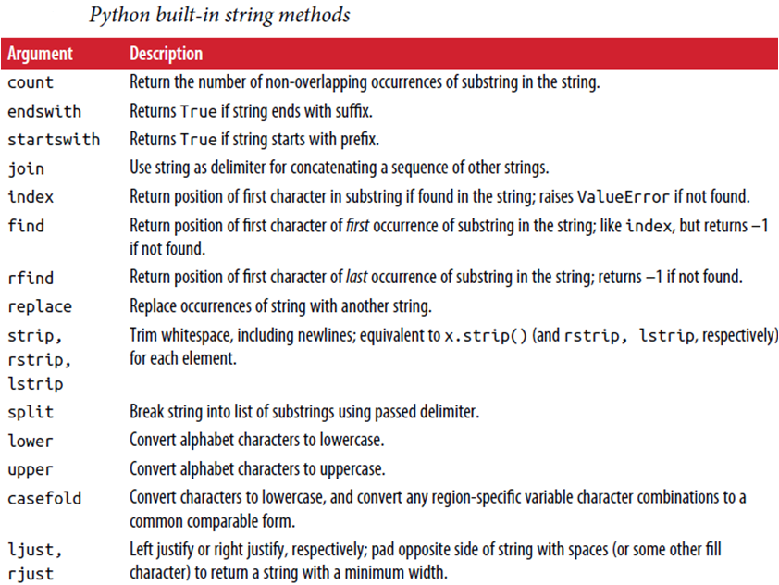

Slide 46
Regular Expressions
Regular expressions provide a flexible way to search or match (often more complex) string patterns in text.
Python’s built-in re module is responsible for applying regular expressions to strings
The re module functions fall into three categories: pattern matching, substitution, and splitting.
In [148]: import re
In [149]: text = "foo bar\t baz \tqux"
In [150]: re.split('\s+', text)
Out[150]: ['foo', 'bar', 'baz', 'qux']

Slide 47
When we call re.split('\s+', text), the regular expression is first compiled, and then its split method is called on the passed text. We can compile the regex ourself with re.compile, forming a reusable regex object:
In [151]: regex = re.compile('\s+')
In [152]: regex.split(text)
Out[152]: ['foo', 'bar', 'baz', 'qux']
If, instead, we wanted to get a list of all patterns matching the regex, we can use the findall method:
In [153]: regex.findall(text)
Out[153]: [' ', '\t ', ' \t']
Creating a regex object with re.compile is highly recommended if we intend to apply the same expression to many strings; doing so will save CPU cycles.

Slide 48
Vectorized String Functions in pandas
data = {'Dave': 'dave@google.com', 'Steve': 'steve@gmail.com', 'Rob': 'rob@gmail.com', 'Wes': np.nan}
In [168]: data = pd.Series(data)
In [169]: data
Out[169]:
Dave dave@google.com
Rob rob@gmail.com
Steve steve@gmail.com
Wes NaN
dtype: object
In [170]: data.isnull()
Out[170]:
Dave False
Rob False
Steve False
Wes True
dtype: bool

Slide 49
In [171]: data.str.contains('gmail')
Out[171]:
Dave False
Rob True
Steve True
Wes NaN
dtype: object
Regular expressions can be used, too, along with any re options like IGNORECASE:
In [172]: pattern
Out[172]: '([A-Z0-9._%+-]+)@([A-Z0-9.-]+)\\.([A-Z]{2,4})'
In [173]: data.str.findall(pattern, flags=re.IGNORECASE)
Out[173]:
Dave [(dave, google, com)]
Rob [(rob, gmail, com)]
Steve [(steve, gmail, com)]
Wes NaN
dtype: object

Slide 50
There are a couple of ways to do vectorized element retrieval. Either use str.get or index into the str attribute:
In [174]: matches = data.str.match(pattern, flags=re.IGNORECASE)
In [175]: matches
Out[175]:
Dave True
Rob True
Steve True
Wes NaN
dtype: object
We can similarly slice strings using this syntax:
In [178]: data.str[:5]
Out[178]:
Dave dave@
Rob rob@g
Steve steve
Wes NaN
dtype: object

Slide 51
